Slide 1

Introduction to Machine Learning

Slide 2

Agenda
What is a Decision Tree?
Introduction to Random Forest
Overview of Boosting Techniques
Key Comparisons
Applications and Real-world Use Cases

Slide 3
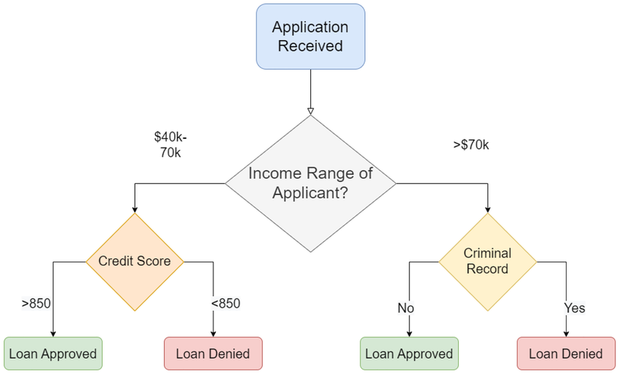
Decision Trees - Introduction
Definition
A Decision Tree is a tree-like structure where nodes represent decisions, branches represent conditions, and leaves represent outcomes.
Source: https://www.researchgate.net/figure/An-algorithm-designed-to-predict-loan-approval-applicants-visualised-through-decision-tree_fig7_373382966
Key Features
Simple, interpretable, and non-linear decision-making.
Handles both classification and regression tasks.

Slide 4
Decision Trees - How It Works
Process:
Start at the root.
1
Split data based on a feature and condition (e.g., Gini index, entropy).
2
Repeat until criteria (e.g., depth, minimum samples) are met.
3

Slide 5
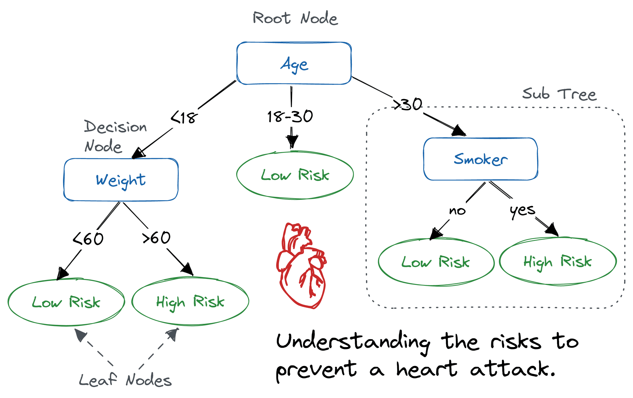
Key Concepts
Splitting Criteria: Gini Index, Information Gain.
01
Credits: https://www.datacamp.com/tutorial/decision-tree-classification-python
02
Pruning: Reducing overfitting.

Slide 6
Decision Trees – Pros and Cons
Advantages:
Easy to interpret.
No need for feature scaling.
Handles categorical and numerical data.
Disadvantages:
Prone to overfitting.
Sensitive to small changes in data.

Slide 7
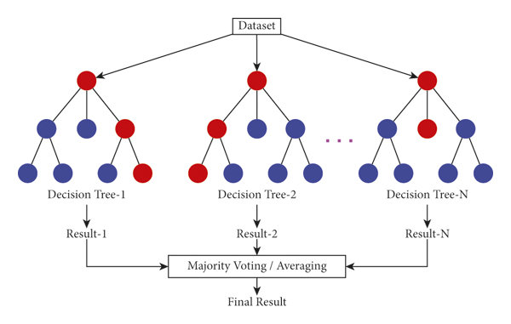
Random Forest - Introduction
Definition
A Random Forest is an ensemble method combining multiple decision trees to improve accuracy and reduce overfitting.
Source: https://www.researchgate.net/figure/Illustration-of-random-forest-trees_fig4_354354484
Uses bagging (Bootstrap Aggregating).
Each tree gets a random subset of data and features.
Key Features

Slide 8
Random Forest - How It Works
Random samples (with replacement).
Build a decision tree for each sample.
Aggregate results (majority voting or averaging).
1
2
3

Slide 9
Random Forest - Pros and Cons
Advantages:
Robust to overfitting.
Handles large datasets well.
Works for both classification and regression.
Disadvantages:
Less interpretable than a single decision tree.
Slower than individual models.

Slide 10
Boosting - Introduction
Definition
Boosting is an ensemble technique that builds models sequentially, focusing on correcting the errors of the previous models.
Popular Algorithms:
AdaBoost
Gradient Boosting Machines (GBM)
XGBoost, LightGBM, CatBoost

Slide 11
Boosting - How It Works
Build
Build an initial weak model.
Focus on
Focus on misclassified samples (adjust weights).
Combine
Combine weak models to create a strong model.

Slide 12
Boosting - Pros and Cons
Advantages:
High accuracy.
Handles complex patterns in data.
Disadvantages:
More prone to overfitting if not tuned well.
Computationally expensive.

Slide 13
Key Comparisons
Feature | Decision Tree | Random Forest | Boosting
Overfitting | High | Low | Moderate
Accuracy | Moderate | High | Very High
Speed | Fast | Slower | Slowest
Interpretability | High | Moderate | Low

Slide 14
Applications and Use Cases
Decision Trees:
Loan approval, customer segmentation.
Random Forest:
Fraud detection, healthcare diagnostics.
Boosting:
Predicting stock prices, recommendation systems.

Slide 15
Confusion Matrix
What is a Confusion Matrix?
A confusion matrix is a table used to evaluate the performance of a classification model.
It compares the actual target values with the predictions made by the model.
Actual / Predicted | 0 (Negative) | 1 (Positive)
0 (Negative) | TN | FP
1 (Positive) | FN | TP
True Positive (TP): Correctly predicted positive cases.
False Positive (FP): Predicted positive but was actually negative (Type I Error).
True Negative (TN): Correctly predicted negative cases.
False Negative (FN): Predicted negative but was actually positive (Type II Error).

Slide 16
Why Use a Confusion Matrix?
Accuracy: (TP+TN) / (TP+TN+FP+FN)
Precision: TP / (TP+FP) Measures the proportion of correct positive predictions.
Recall (Sensitivity): TP / (TP+FN) Measures the model's ability to find all positive cases.
F1-Score: Harmonic mean of precision and recall:
F1=2× (Precision × Recall) / (Precision + Recall)

Slide 17
Why Use a Confusion Matrix?

Slide 18
Thank You!

